Slide 1

Anomaly Detection in Payments
IE 406 : Machine Learning
Group no. 18
Assigned By
Prof. M.V. Joshi

Slide 2
Problem Statement
In training dataset, there are transactions made by credit cards in September 2013 by european cardholders. We want to to separate fraud and non-fraud transactions by obtaining a decision boundary in the feature space defined by input transactions using supervised binary classifiers. In addition to that because of Imbalanced dataset and concept drift, We are going to use unsupervised algorithms which detects outlier (Fraudulent transactions). Compare these models to know which model has best results for given dataset.

Slide 3

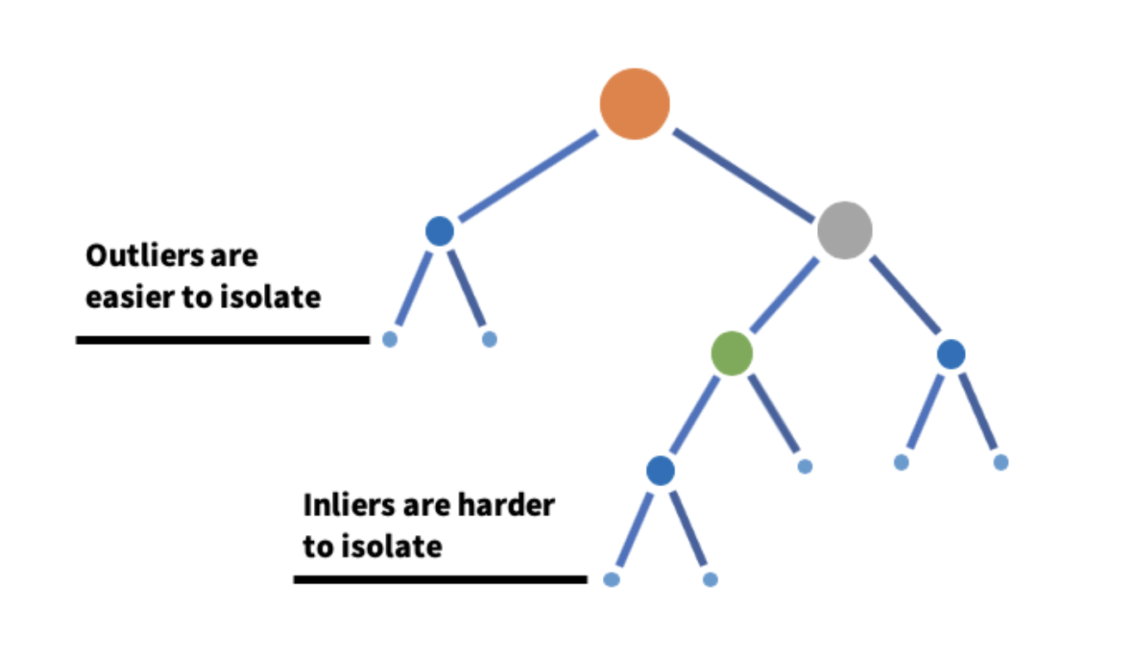
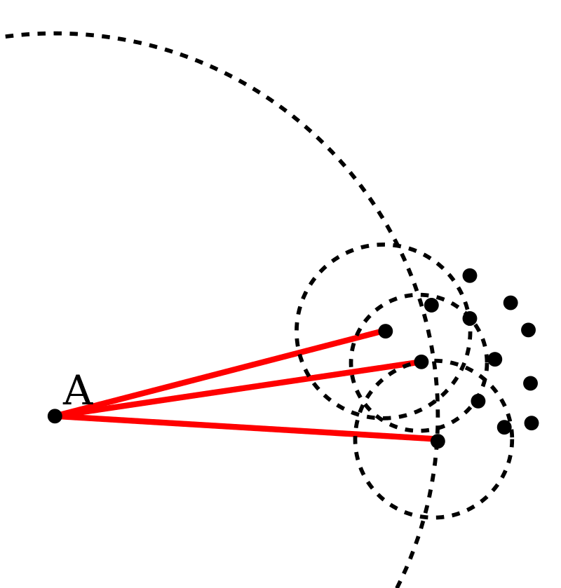
Models which we are going to use
Isolation Forest :-
[5]
Logistic Regression
SVM (kernel)
Isolation Forest
Local Outlier Factor
Basic idea of LOF :- comparing the local density of a point with the densities of its neighbors. A has a much lower density than its neighbors.[4]

Slide 4
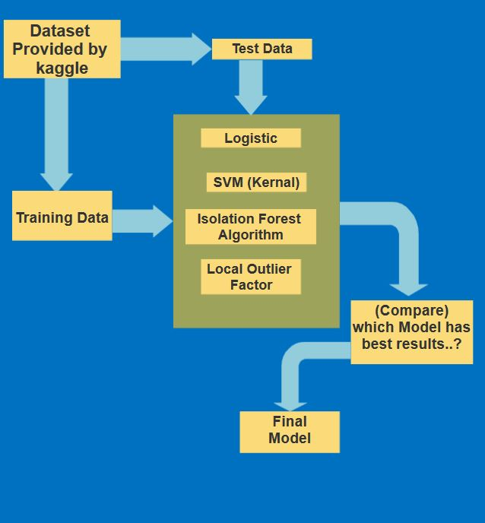
Block Diagram:-

Slide 5
Previous Works / Dataset / References
Dataset : https://www.kaggle.com/mlg-ulb/creditcardfraud
Local Outlier Factor, Isolation Forest : https://ieeexplore.ieee.org/document/8741421
Logistic regression, SVM, Random Forest : https://ieeexplore.ieee.org/stamp/stamp.jsp?tp=&arnumber=8757212
https://en.wikipedia.org/wiki/Local_outlier_factor
https://content.linkedin.com/content/dam/engineering/site-assets/images/blog/posts/2019/08/IsolationForest1.png

Slide 6

Thank You..!

